Slide 1
Data Mining
Ch 6 : Mining Frequent Patterns, Associations, and Correlations - 4
Wan D. Bae, Ph.D.
baewd@hanyang.ac.kr

Slide 2
Overview
Basic concepts of frequent patterns
Algorithms for scalable frequent itemset mining in transactional databases
Interestingness measurement of correlated events

Slide 3
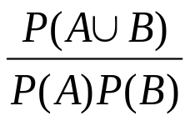

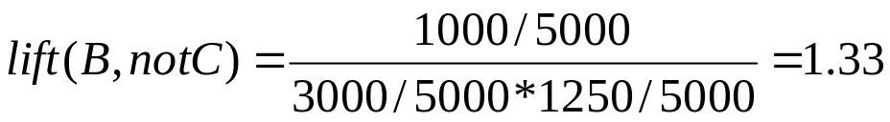
Interestingness Measure: Correlations
Play basketball ⇒ eat cereal [40%, 66.7%] is misleading
  The overall % of students eating cereal is 75% > 66.7%
Play basketball ⇒ not eat cereal [20%, 33.3%] is more accurate, although with lower support and confidence
Measure of dependent/correlated events: lift =
Example:
 | Basketball | Not basketball | Sum (row)
Cereal | 2000 | 1750 | 3750
Not cereal | 1000 | 250 | 1250
Sum(col.) | 3000 | 2000 | 5000

Slide 4

Interestingness Measures
“Buy walnuts ⇒ buy milk [1%, 80%]” is misleading if 85% of customers buy milk
Support and confidence are not good to indicate correlations

Slide 5
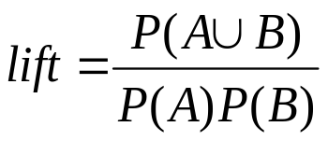
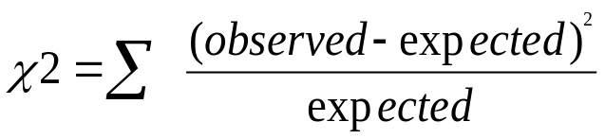

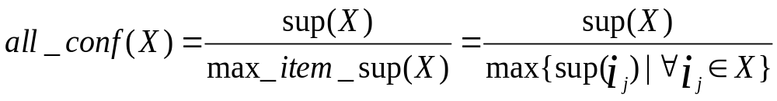
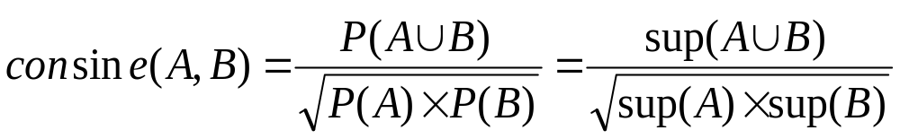
Interestingness Measure: Correlations
Correlation analysis using lift :
Correlation analysis using :
Correlation analysis using all_confidence :
Correlation analysis using cosine :

Slide 6

Interestingness Measures

Slide 7

Interestingness measures & Null-Invariance
Null-invariance: Value does not change with # of null-transactions
A few interestingness measures: some are null invariant
χ² and lift are not null-invariant
Kulczynski measure

Slide 8

Null Invariance: An Important Property
Why is null invariance crucial for the analysis of massive transaction data?
  Many transactions may contain neither milk nor coffee!
Example: milk vs. coffee contingency table
 | Milk | No Milk | Σ row
Coffee | m, c | ~m, c | c
No Coffee | m, ~c | ~m, ~c | ~c
Σ col | m | ~m | Σ
  χ² and lift are not null-invariant:
  not good to evaluate data that contains
  too many or too few null transactions
Subtle: They disagree
Data Mining: Concepts and Techniques

Slide 9
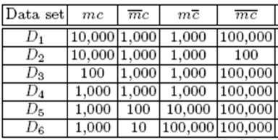
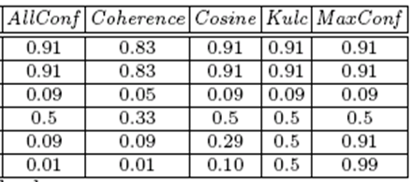
Comparison of Null-Invariant Measures
Not all –null-invariant measures are created equal
2-variable contingency table
 | Milk | No Milk | Σ row
Coffee | m, c | ~m, c | c
No Coffee | m, ~c | ~m, ~c | ~c
Σ col | m | ~m | Σ
All 5 are null-invariant
Subtle: They disagree on those cases

Slide 10


Which Null-Invariant Measure Is Better?
IR (Imbalance Ratio): measure the imbalance of two itemsets A and B in rule implications
Kulczynski and Imbalance Ratio (IR) together present a clear picture for all the three datasets D₄ through D₆
  D₄ is neutral and balanced
  D₅ is neutral but imbalanced
  D₆ is neutral but very imbalanced

Slide 11

Analysis of DBLP Coauthor Relationships
Recent DB conferences, removing balanced associations, low sup, etc.
Advisor-advisee relation:
Kulc: high, coherence: low, cosine: middle
Use Kulc and imbalanced ratio (IR) to find advisor-advisee relationships and close collaborators

